Slide 1
Pivotal Cloud Foundry - Architecture
Notes:
© 2006 Capgemini - All rights reserved

Slide 2
Objectives of PCF
Purpose:
  To learn pivotal cloud foundry architecture.
Product:
  Components
  Health Manager
Process:
  To understand the Cloud Foundry Architecture
© 2014 Capgemini - All rights reserved

Slide 3
Pivotal Cloud Foundry Architecture
  Pivotal CF Components
  Load Balancer ( HA Proxy)
  Router
  Cloud Controller
  BlobStore
  Cloud Controller Data Base(CC DB)
  Avalilability Zones
  Droplet Execution Agents(DEA)
  Warden Container
  Service Broker
  Health Manager
  Messaging (NATS)
  Loggregator
  UAA and Login Services
  Cloud Foundry BOSH
© 2014 Capgemini - All rights reserved

Slide 4
  Pivotal Cloud Foundry Architecture
© 2011 Capgemini - All rights reserved

Slide 5

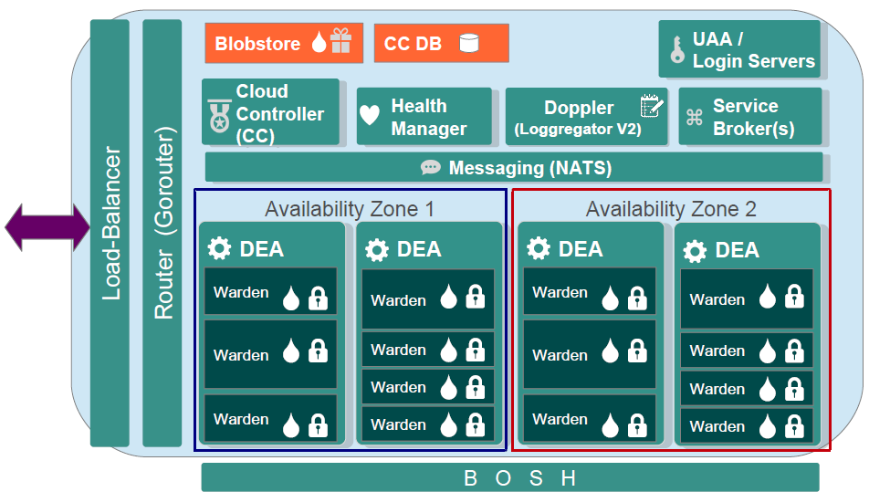
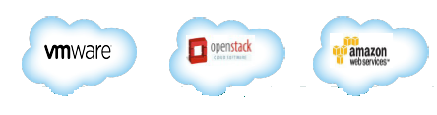
Pivotal CF Components – 1.4
DEA → Droplet Execution Agent
UAA → User Authorization & Authentication
© 2007 Capgemini - All rights reserved

Slide 6

Load Balancer ( HA Proxy)
Description
Responsible For
HAProxy is separate component from the Router
  Sits in front of the Router
  Only one instance allowed
    Single – point of failure
Cloud Foundry can only have one IP address visible to outside
  This is the Load Balancer
  It passes requests to the Router(s) to send the right CF component
Load – Balancing across multiple routers (if used)
SSL termination
Note: Typically need to configure your own HAProxy or other load- balancer (such as F5 or NSX) for improved performance SSL handling and high availability.
© 2007 Capgemini - All rights reserved

Slide 7
Router
Description
Responsible For
Routes all incoming HTTP traffic
  System traffic (cf commands)
  Application traffic
Maintains dynamic routing table for each load-balanced app instance
  Knows IP addresses and ports.
Multiple routers possible
  Configurable by admin in Ops Manger
From CF 1.4 rewritten in Go – the GoRouter
Load balancing across application instances
Maintaining an active routing table
Access logs
Supports web-sockets
In CF 1.6 will also do SSL termination
© 2011 Capgemini - All rights reserved
© 2007 Capgemini - All rights reserved

Slide 8

Cloud Controller
Description
Responsible For
Command and Control
  Responds to clients (CLI, web UI, Spring STS)
  Account and provisioning control
Provides RESTful interface to domain objects
  Apps, services, organizations, spaces, service instances, user role , and more …
Multiple Cloud Controllers possible
  Configurable by admin
Expected Application state, state transitions, and desired convergence
Permissions/ Authorization
Organizations / Spaces / Users
Service management
Application placement
Auditing / Journaling and billing events
Blob storage
© 2011 Capgemini - All rights reserved
© 2007 Capgemini - All rights reserved

Slide 9

BlobStore
Description
Responsible For
Storage for binary large objects
Eliminates need for upload / re-staging when scaling applications
Currently NFS mounted storage
  Or Amazon S3 store
Store uploaded application packages ( cf push)
Stores Droplets
© 2011 Capgemini - All rights reserved
© 2007 Capgemini - All rights reserved

Slide 10

Cloud Controller DataBase
Description
Responsible For
Storage for application metadata
Used exclusively by the Cloud Controller
Stores information on
  Application name
  # of instances requested
  memory limit
  Routes
  Bound Services
A Postgres DB instance
© 2011 Capgemini - All rights reserved
© 2007 Capgemini - All rights reserved

Slide 11

Availability Zones
Description
Responsible For
Separate shared points of failure such as a power, network, cooling, roof, floor.
Allows Cloud Controller to locate instances on separate zones to boost redundancy.
Marked on diagram as:
Enhancing application redundancy
Provides one of the layers of High Availability
© 2011 Capgemini - All rights reserved
© 2007 Capgemini - All rights reserved

Slide 12

Droplet Execution Agents ( DEA )
Description
Responsible For
Secure and fully isolated containers
  Actually a Linux VM
Responsible for an apps lifecycle
  Building, starting and stopping Apps as instructed
Periodically broadcast messages about their state
  Via the NATS message bus.
Typically many DEAs in a Cloud Foundry installation
Managing Linux containers
  Pivotal’s Warden containers
Monitoring resource pools
  Process
  File System
  Network
  Memory
Managing app life cycle
App log and file streaming
DEA heartbeats
  Via NATS to Cloud Controller & Health Manager
© 2011 Capgemini - All rights reserved
© 2007 Capgemini - All rights reserved

Slide 13
Warden Container
Description
Responsible For
Isolated Process
  Safe, lightweight alternative to full VM
  Runs a Droplet
Pivotal’s secure implementation of LXC (Secure Linux Container)
Isolates application from each other
Allows multiple applications running on each VM
Isolates application running on the same VM
  Individual failures does not affect other applications on the VM
  Uses kernel namespaces to isolate network, disk, memory and CPU
  Uses Linux cgroups to do resource management
Secures applications from environment
Runs Droplets
© 2011 Capgemini - All rights reserved
© 2007 Capgemini - All rights reserved

Slide 14

Service Broker
Description
Responsible For
Provide an interface for native and external 3rd party services
  Service processes run on Service nodes
  Or with external as-a-service providers
Examples
  Mail server
  Database
  Messaging
  Many more …
Typically one service broker for each marketplace service.
Advertising service catalog
Makes create /delete/ bind / unbind calls to service nodes
Request inventory of existing instances and bindings from cloud controller for caching, orphan management
SaaS marketplace gateway
© 2011 Capgemini - All rights reserved
© 2007 Capgemini - All rights reserved

Slide 15

Health Manager
Description
Responsible For
Monitors application uptime
Listens to NATS message bus for mismatched application states (expected vs. actual)
  Cloud Controller publishes expected state
  DEAs public actual state
state mismatches are reported to the Cloud Controller.
Multiple Health Managers possible
Maintains the actual state of apps
Compares to expected state
Sends suggestions to make actual match expected
  Cannot make state changes itself – only Cloud Controller can do that!
© 2011 Capgemini - All rights reserved
© 2007 Capgemini - All rights reserved

Slide 16

Messaging (NATS)
Description
Responsible For
Fast internal messaging bus
Manages system – wide communication
Uses a publish-and-subscribe mechanism
Not – Another Transport system
Single NATS per Cloud Foundry installation
Non- persistent messaging
Pub/Sub
Queues (app events)
Directed messages ( INBOX )
© 2011 Capgemini - All rights reserved
© 2007 Capgemini - All rights reserved

Slide 17

Loggregator
Description
Responsible For
Master logging process
  Accepts logs from application instances
  Accepts logs from other CF components
Make log data available to external sinks
Uses Diego’s Doppler Server since CF 1.4
Non-persistent, temporary log-storage
Accumulates logs from multiple storage and aggregates by application
Provides logs to external sources such as cf logs or App manager console
Supports log “drains” to syslog servers
© 2011 Capgemini - All rights reserved
© 2007 Capgemini - All rights reserved

Slide 18

UAA and Login Services
Description
Responsible For
UAA =“ User Authorization and Authentication”
Provides identity, security and authorization services.
Manages third party OAuth 2.0 access credentials
Can provide application access & identity-as-a-service for CF apps
Composed of
  UAA Server
  Command Line Interface
  Library
Multiple UAA/Login Servers possible
Token server
ID Server (User Management)
OAuth Scopes (Groups) and SCIM
Login Server
  UAA Database
  SAML support (for SSO integration) and Active Directory support with the VMWare SSO Appliance
Access auditing
© 2011 Capgemini - All rights reserved
© 2007 Capgemini - All rights reserved

Slide 19

Cloud Foundry BOSH
Description
Responsible For
Tool Chain for managing large scale distributed systems
  Release engineering
  Deployment and lifecycle management
Continuous and predictive updates with minimal downtime
Control primitive (CPI) written for each underlying infrastructure provider
  The ‘glue’ between CF and underlying IaaS
IaaS installer
  Currently vSphere
VM creation and management
Continuous and predictive updates with minimal downtime
High Availability
  Restarts failed CF internal processes, DEAs
CPI (Cloud Provider Interface ) to control underling infrastructure (IaaS) primitives
© 2011 Capgemini - All rights reserved
© 2007 Capgemini - All rights reserved

Slide 20
Health manager
Monitor applications to determine version, current state and number of instances
  Actual state of an application is based on heartbeats from DEAs running the application
Determine applications’ desired state, version, and instances and compare to actual state
  Desire state based upon the Cloud Controller database
Direct Cloud Controller to take action to correct any discrepancies in the state of applications.
© 2011 Capgemini - All rights reserved

Slide 21
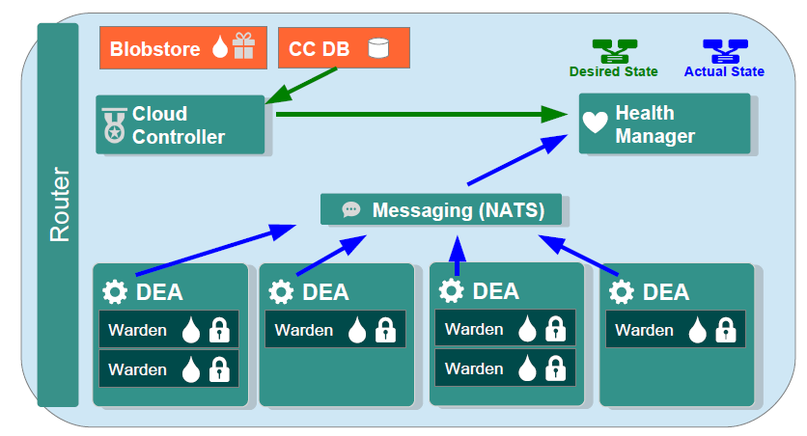
Health Management – how it works?
Application run within containers on DEAs
DEAs send heartbeats messages, messages sent to Health Manager
Health Manager obtains “desired state” from Cloud Controller
Does “desired state” = “ actual state” ? Yes
© 2011 Capgemini - All rights reserved

Slide 22
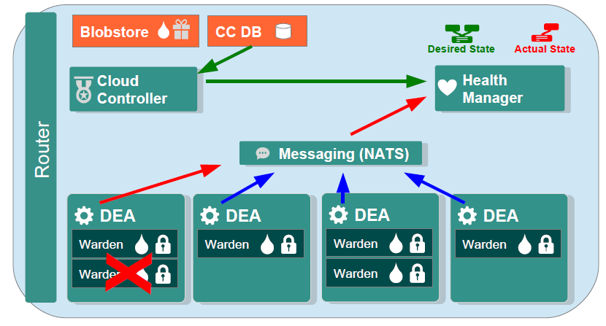
Health Management – Detecting Failures
What if an application crashes X?
DEAs send heartbeat messages, messages sent to Health Manager
Health Manager obtain “desired state” from Cloud Controller
“Desired state” = “actual state” ? No
© 2011 Capgemini - All rights reserved

Slide 23
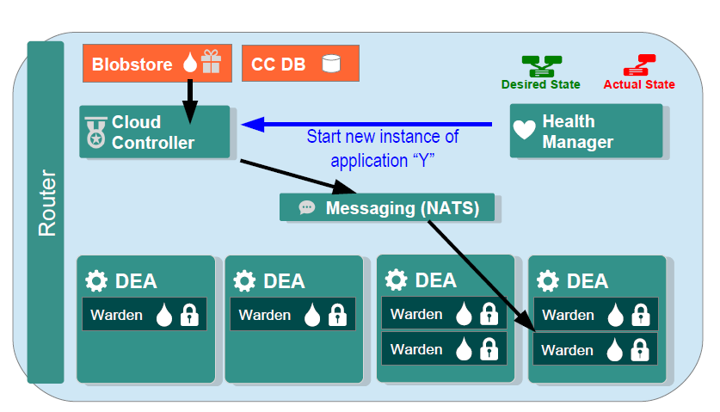
Health Management – Replacing an Application
Health Manager instructs Cloud Controller
Cloud Controller Clones Droplet into container on DEA
© 2011 Capgemini - All rights reserved

Slide 24
Recap
CCDB
Load Balancer
Availability Zone
DEA
Warden
Droplets
HealthManager
© 2014 Capgemini - All rights reserved
Notes:
Recap – tips : To make it further lighter, many facilitator ask participant that they were allow to leave only if they will answer say 12 correct answers out of 15 questions. And then produce all recaps as questions.
© 2006 Capgemini - All rights reserved

Slide 25
Notes:
© 2006 Capgemini - All rights reserved

